Slide 1
Chapter 4
Control Statements: Part I; Assignment, ++ and -- Operators
Java How to Program, 11/e
Questions? E-mail paul.deitel@deitel.com

Slide 2
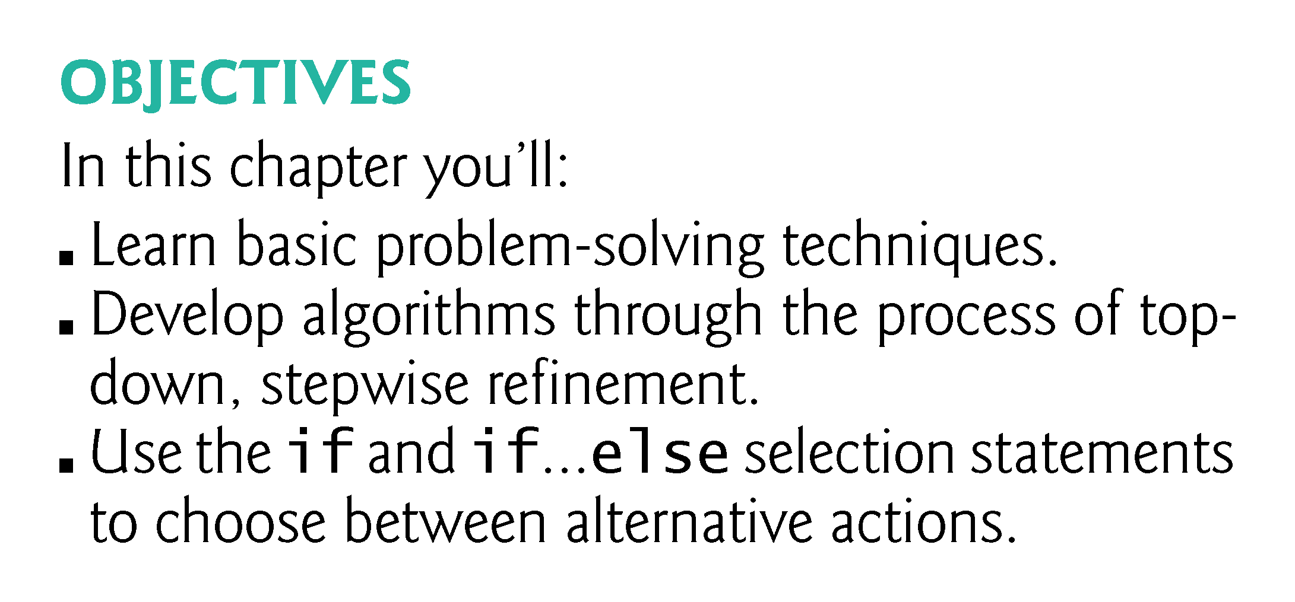

Slide 3
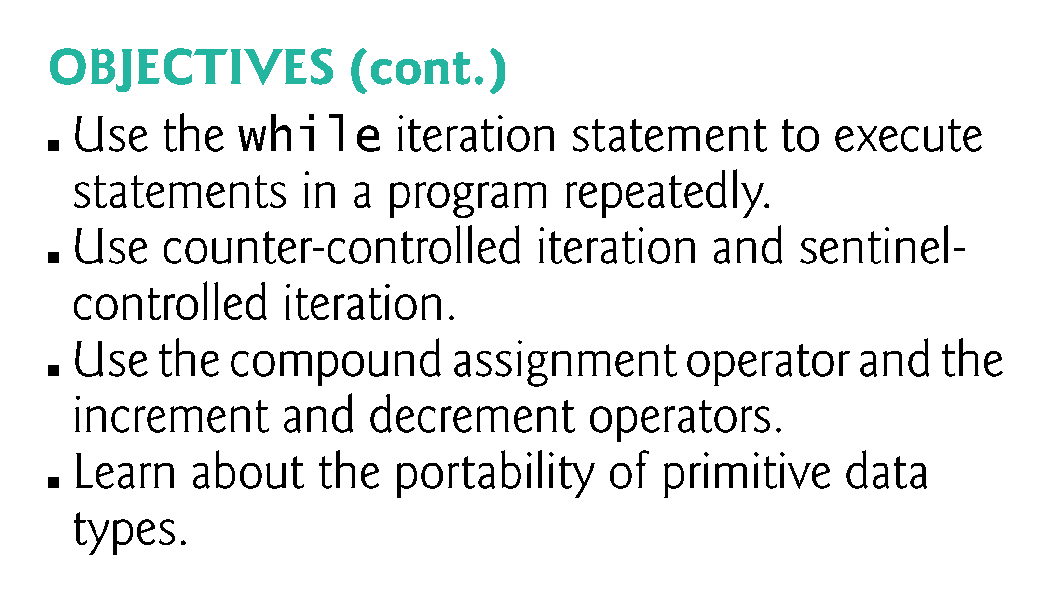

Slide 4
4.4 Control Structures
Sequential execution: Statements in a program execute one after the other in the order in which they are written.
Transfer of control: Various Java statements, enable you to specify that the next statement to execute is not necessarily the next one in sequence.
Bohm and Jacopini
  Demonstrated that programs could be written without any goto statements.
  All programs can be written in terms of only three control structures—the sequence structure, the selection structure and the iteration structure.
When we introduce Java’s control-structure implementations, we’ll refer to them in the terminology of the Java Language Specification as “control statements.”

Slide 5
4.4 Control Structures (Cont.)
Sequence Structure in Java
Built into Java.
Unless directed otherwise, the computer executes Java statements one after the other in the order in which they’re written.
The activity diagram in Fig. 4.1 illustrates a typical sequence structure in which two calculations are performed in order.
Java lets you have as many actions as you want in a sequence structure.
Anywhere a single action may be placed, we may place several actions in sequence.

Slide 6
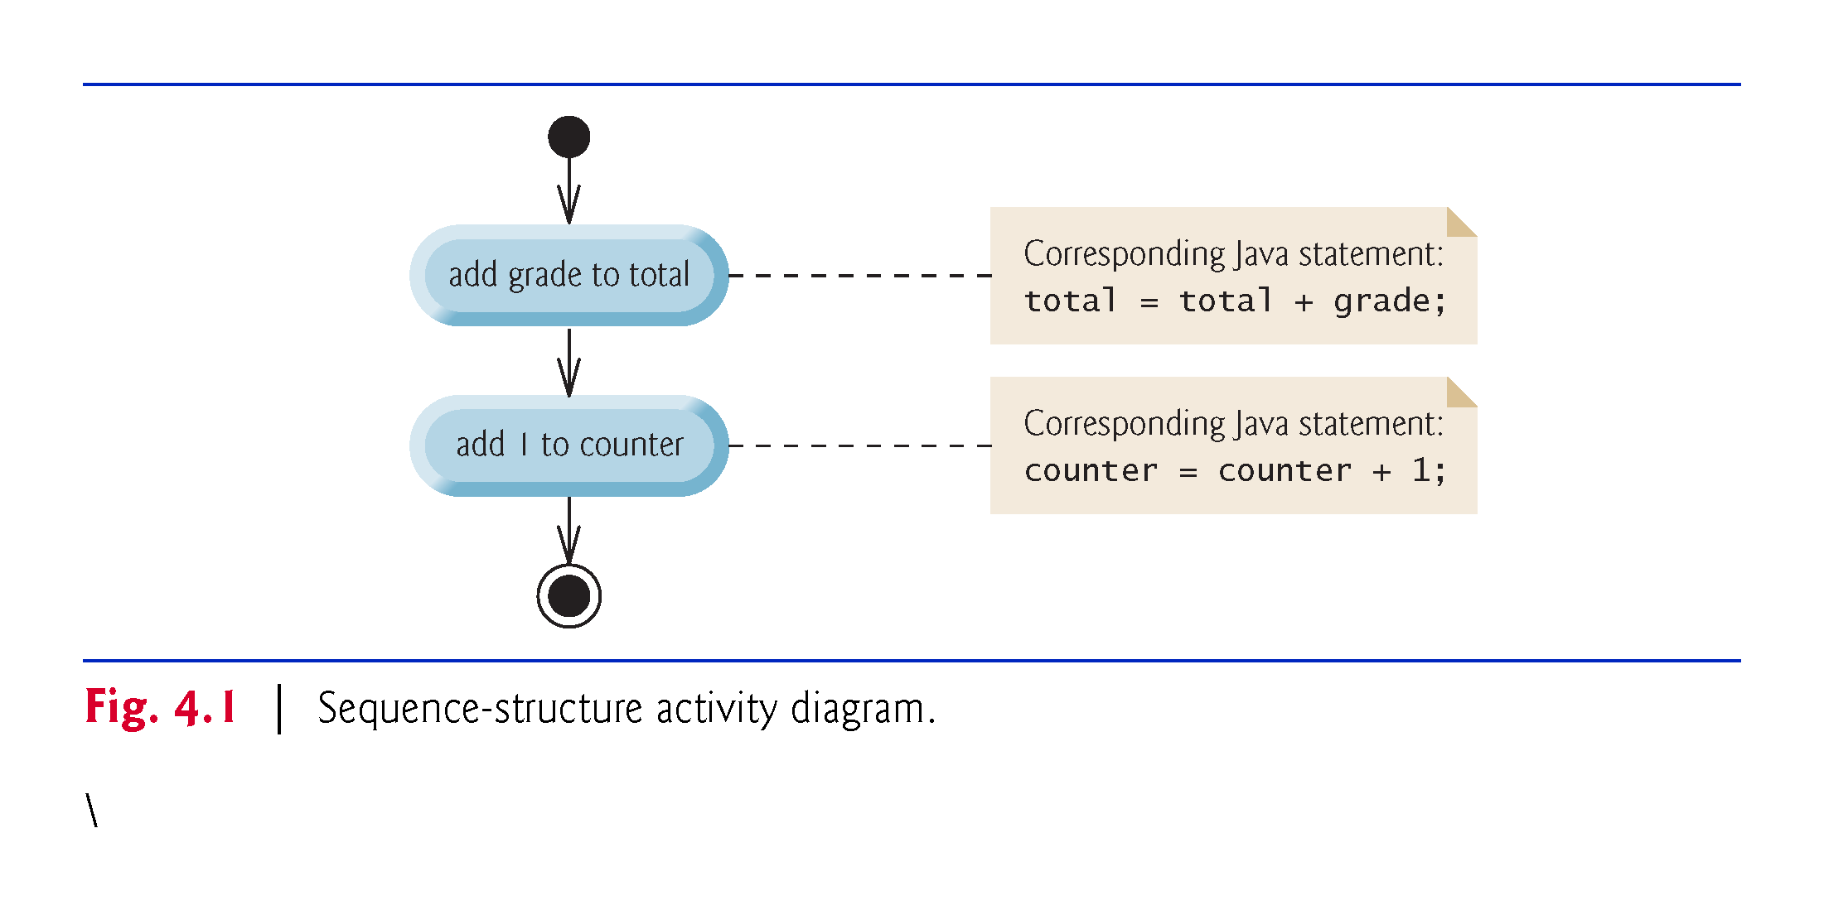

Slide 7
4.4 Control Structures (Cont.)
Selection Statements in Java
Three types of selection statements.
if statement:
  Performs an action, if a condition is true; skips it, if false.
  Single-selection statement—selects or ignores a single action (or group of actions).
if…else statement:
  Performs an action if a condition is true and performs a different action if the condition is false.
  Double-selection statement—selects between two different actions (or groups of actions).
switch statement
  Performs one of several actions, based on the value of an expression.
  Multiple-selection statement—selects among many different actions (or groups of actions).

Slide 8
4.4 Control Structures (Cont.)
Iteration Statements in Java
Four iteration statements (also called iteration statements or looping statements)
  Perform statements repeatedly while a loop-continuation condition remains true.
while and for statements perform the action(s) in their bodies zero or more times
  if the loop-continuation condition is initially false, the body will not execute.
The do…while statement performs the action(s) in its body one or more times.
Chapter 7 presents the enhanced for statement.
if, else, switch, while, do and for are keywords.
  Appendix C: Complete list of Java keywords.

Slide 9
4.6 if…else Double-Selection Statement (Cont.)
Nested if…else Statements
A program can test multiple cases by placing if…else statements inside other if…else statements to create nested if…else statements.
Pseudocode:
    If student’s grade is greater than or equal to 90
    Print “A”
    else
    If student’s grade is greater than or equal to 80
    Print “B”
    else
    If student’s grade is greater than or equal to 70
    Print “C”
    else
    If student’s grade is greater than or equal to 60
    Print “D”
    else
    Print “F”

Slide 10
4.6 if…else Double-Selection Statement (Cont.)
This pseudocode may be written in Java as
    if (studentGrade >= 90) {
    System.out.println("A");
    }
    else {
    if (studentGrade >= 80) {
    System.out.println("B");
    }
    else {
    if (studentGrade >= 70) {
    System.out.println("C");
    }
    else {
    if (studentGrade >= 60) {
    System.out.println("D");
    }
    else {
    System.out.println("F");
    }
    }
    }
    }

Slide 11
4.6 if…else Double-Selection Statement (Cont.)
Conditional operator (?:)
Conditional operator (?:)—shorthand if…else.
Ternary operator (takes three operands)
Operands and ?: form a conditional expression
Operand to the left of the ? is a boolean expression—evaluates to a boolean value (true or false)
Second operand (between the ? and :) is the value if the boolean expression is true
Third operand (to the right of the :) is the value if the boolean expression evaluates to false.

Slide 12
4.6 if…else Double-Selection Statement (Cont.)
Example:
    System.out.println(
    studentGrade >= 60 ? "Passed" : "Failed");
Evaluates to the string "Passed" if the boolean expression studentGrade >= 60 is true and to the string "Failed" if it is false.

Slide 13
4.10 Formulating Algorithms: Sentinel-Controlled Iteration (Cont.)
Cast operators are available for any type.
Cast operator formed by placing parentheses around the name of a type.
The operator is a unary operator (i.e., an operator that takes only one operand).
Java also supports unary versions of the plus (+) and minus (–) operators.
Cast operators associate from right to left; same precedence as other unary operators, such as unary + and unary -.
This precedence is one level higher than that of the multiplicative operators *, / and %.
Appendix A: Operator precedence chart

Slide 14
4.11 Formulating Algorithms: Nested Control Statements
This case study examines nesting one control statement within another.
A college offers a course that prepares students for the state licensing exam for real-estate brokers. Last year, ten of the students who completed this course took the exam. The college wants to know how well its students did on the exam. You’ve been asked to write a program to summarize the results. You’ve been given a list of these 10 students. Next to each name is written a 1 if the student passed the exam or a 2 if the student failed.

Slide 15
4.12 Compound Assignment Operators
Compound assignment operators abbreviate assignment expressions.
Example:
    c = c + 3;
can be written with the addition compound assignment operator, +=, as
    c += 3;
The += operator adds the value of the expression on its right to the value of the variable on its left and stores the result in the variable on the left of the operator.
Statements like
variable = variable operator expression;
where operator is one of the binary operators +, -, *, / or % can be written in the form
    variable operator= expression;

Slide 16
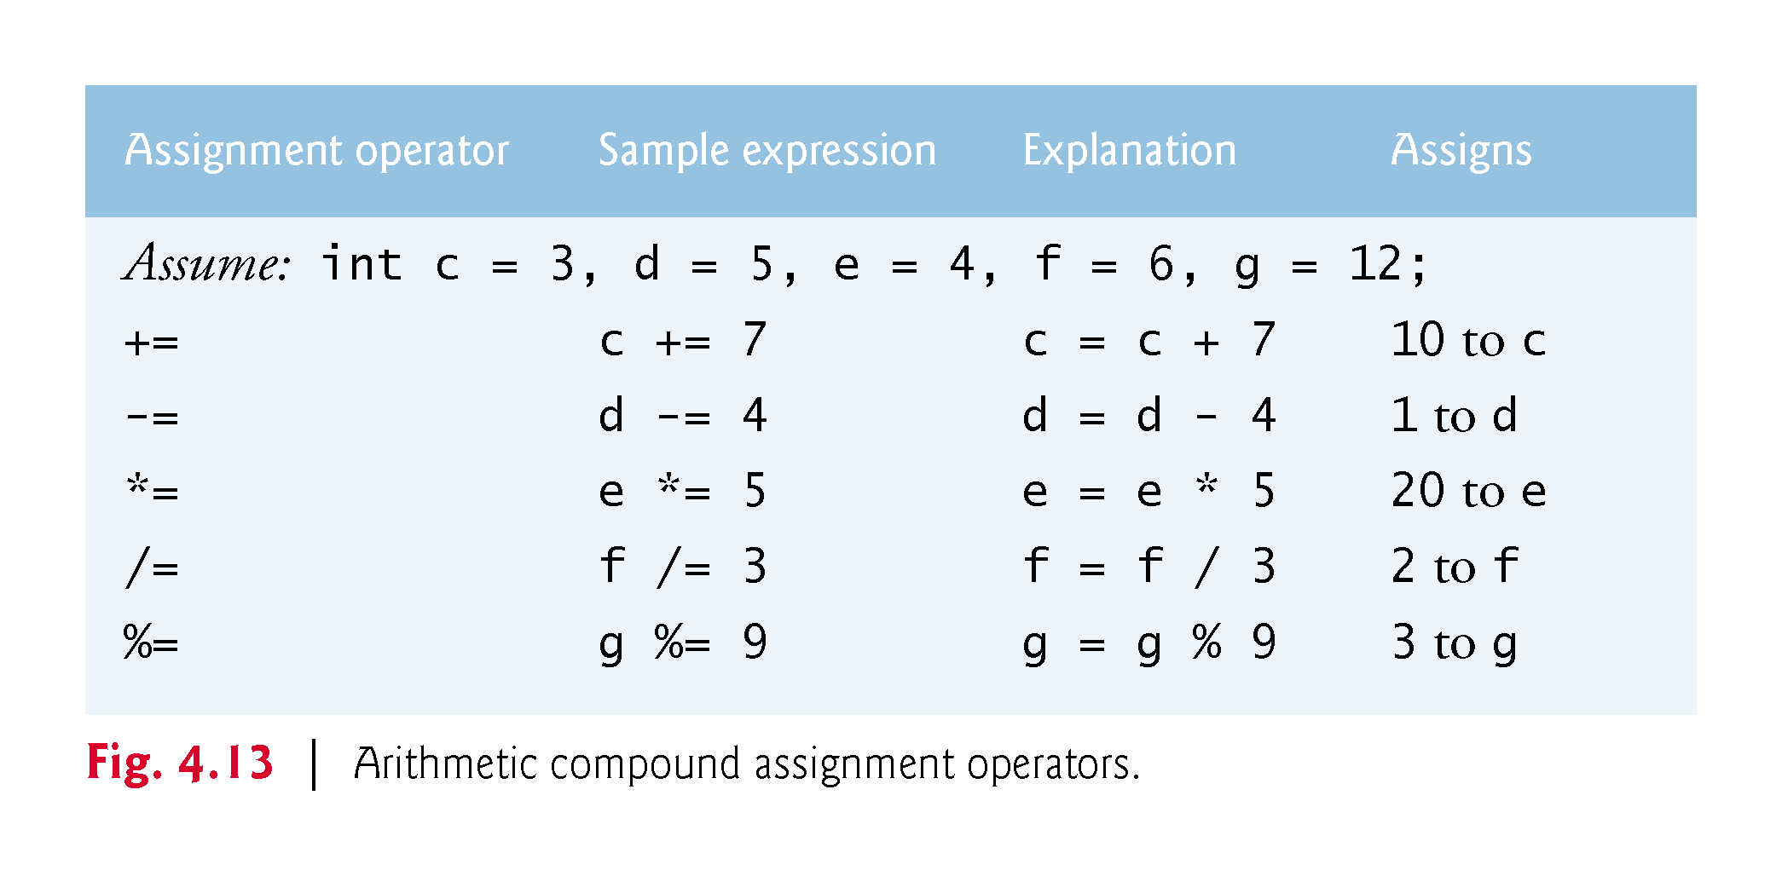

Slide 17
4.13 Increment and Decrement Operators
Unary increment operator, ++, adds one to its operand
Unary decrement operator, --, subtracts one from its operand
An increment or decrement operator that is prefixed to (placed before) a variable is referred to as the prefix increment or prefix decrement operator, respectively.
An increment or decrement operator that is postfixed to (placed after) a variable is referred to as the postfix increment or postfix decrement operator, respectively.

Slide 18
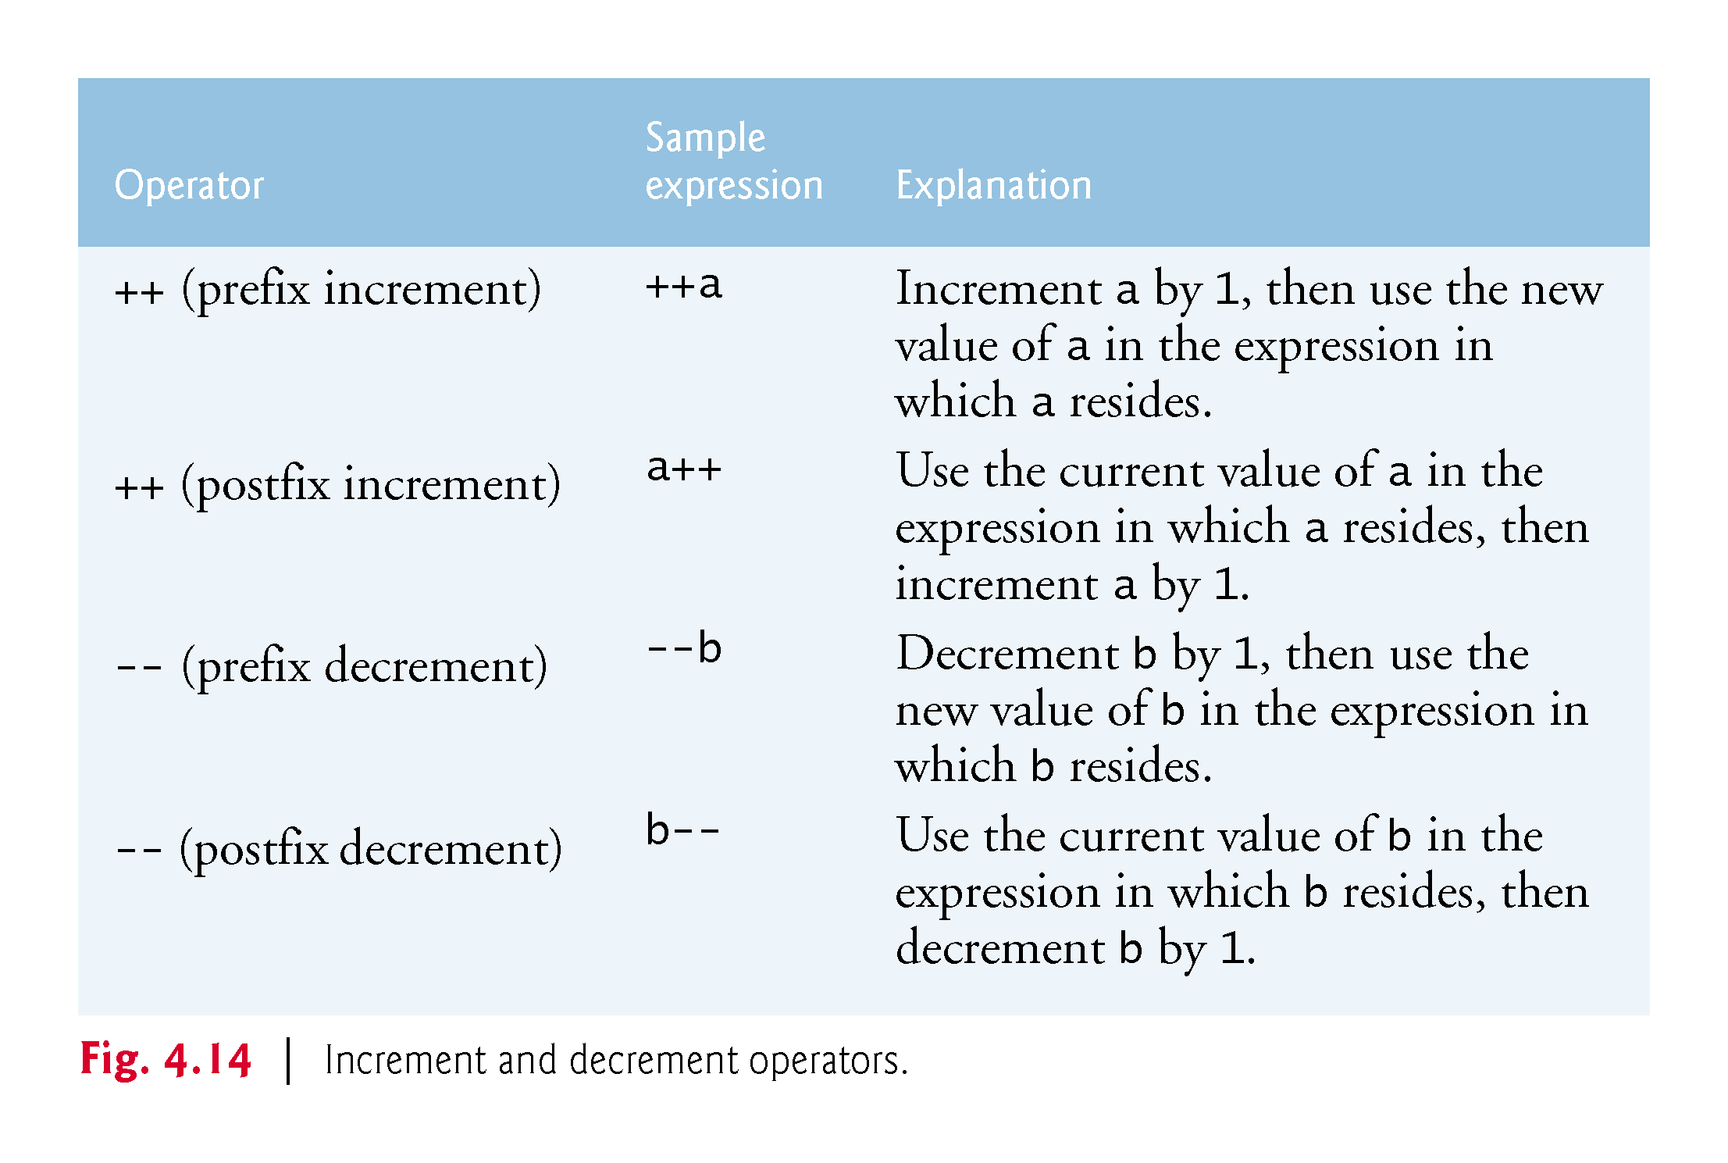

Slide 19
4.12 Increment and Decrement Operators (Cont.)
Using the prefix increment (or decrement) operator to add (or subtract) 1 from a variable is known as preincrementing (or predecrementing) the variable.
Preincrementing (or predecrementing) a variable causes the variable to be incremented (decremented) by 1; then the new value is used in the expression in which it appears.
Using the postfix increment (or decrement) operator to add (or subtract) 1 from a variable is known as postincrementing (or postdecrementing) the variable.
This causes the current value of the variable to be used in the expression in which it appears; then the variable’s value is incremented (decremented) by 1.

Slide 20
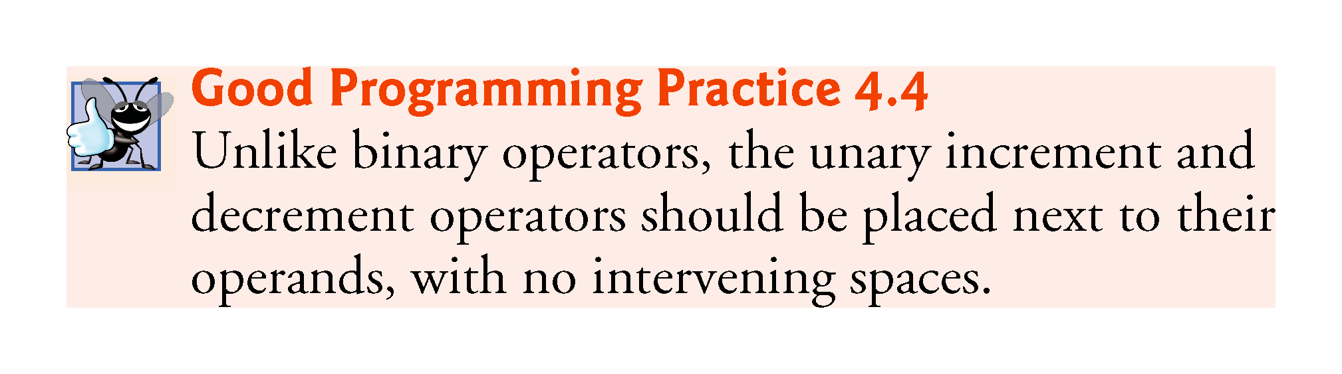

Slide 21
